Slide 1

01
Introduction to NN, CNN and GNN (24113) & Analog System Design (24AIM114)
FOOD ADULTERATION DETECTION
TEAM MEMBERS:
K. Varshitha (CB.AI.U4AIM24122)
Nikitha Sree TY (CB.AI.U4AIM24132)
R. Ashwika (CB.AI.U4AIM24138)
V. Sevita Naidu (CB.AI.U4AIM24150)
TEAM -6

Slide 2
TEAM -6
02
PROBLEM STATEMENT
Adulterants sometimes can be carcinogenic. Consumption of adulterated food may lead to serious health issues like cancer, neurological disorders, reproductive issues, gastro-intestinal issues etc.,
Traditional methods involves both home remedies and laboratory analysis it involves very highly scaled spectrometers which are of high cost and large in size, which would difficult for the experts to carry everywhere during inspection; during performing these methods it can also lead to spoilage/ wastage of food item.

Slide 3
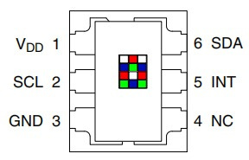
TEAM -6
03
ABOUT THE SENSOR
Detects colors in its surrounding environment and provides a digital return of red, green, blue (RGB) intensity values
Built-in LED
I2C Interface
Adjustable Brightness by PWM
4-Channels (Red, Blue, Green, Clear)
Embedded ADC
TCS34725
Applications:
Fluid and Gas Analysis
Medical and Health Fitness
Consumer and Commercial Printing

Slide 4
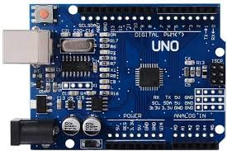
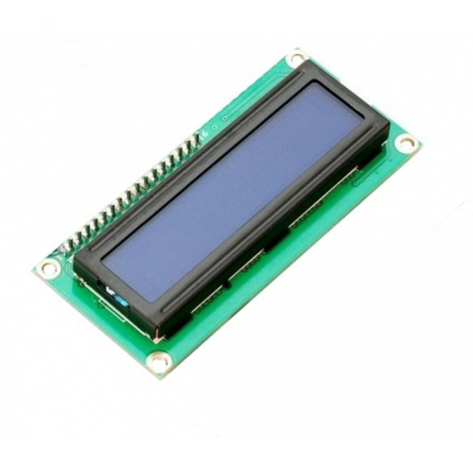
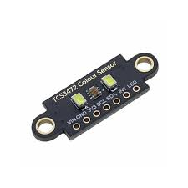
TEAM -6
04
COMPONENTS USED
TCS34725 Sensor
Arduino UNO
LCD Display
Resistors
Jumping Wires
Bread Board

Slide 5
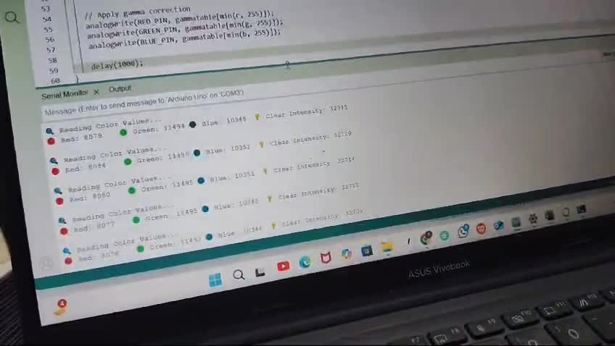
TEAM -6
05
DATA COLLECTION
Sample Used: Turmeric
Adulterant: Corn Flour

Slide 6
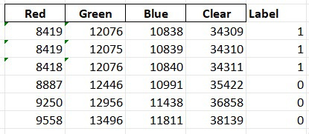
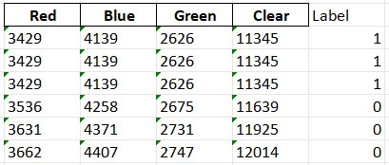
TEAM -6
06
DATASET PREVIEW
WHITE BACKGROUND
BLACK BACKGROUND

Slide 7
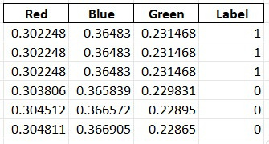
www.reallygreatsite.com
TEAM -6
07
DATA PRE-PROCESSING
Dataset Normalization
Duplicates Removal
Data Augmentation
Splitting of Data
70% - Training
15% - Validation
15 % - Testing

Slide 8
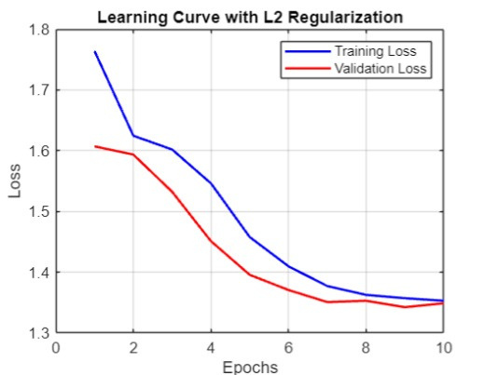
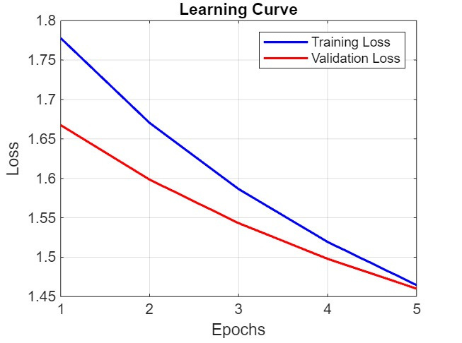


RESULTS
WHITE BACKGROUND
BLACK BACKGROUND
08

Slide 9
TEAM -6
09
FUTURE SCOPE
Multiple-food adulteration detection system
Integration with ESP32
Use of AS7263 Sensor for better detection in visible and IR range

Slide 10
TEAM -6
10
THANK YOU!

